Slide 1
Pi-CAR Final Project
By Parham Gholami, Bradley Khang Tran, Joshua Soteras, Kevin Andersen
(Group 4)

Slide 2
Team Roles
Parham Gholami
Leader Tasks
Bradley Tran
Leader/Follower - PowerPoint
Acceleration
Deceleration
Joshua Soteras
Follower Tasks
Kevin Anderson

Slide 3
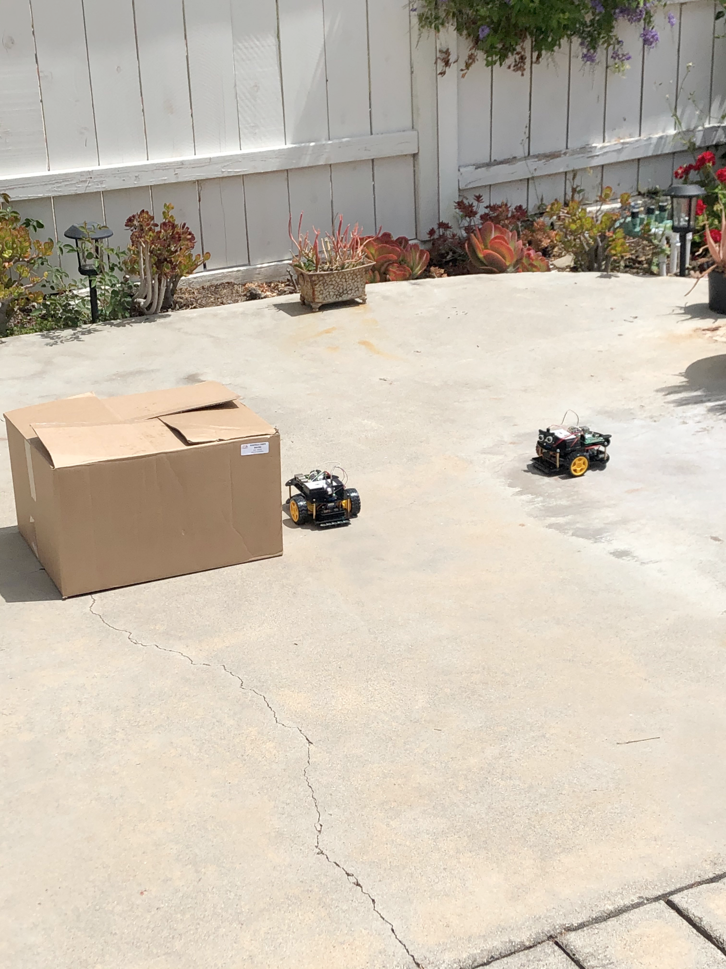
PROBLEMS
Some of the problems we ran into:
The sonic sensor not detecting properly
The follower knocking the leader into the object
The follower getting stuck on the obstacle while following
The leader had some difficulty moving in a straight line

Slide 4
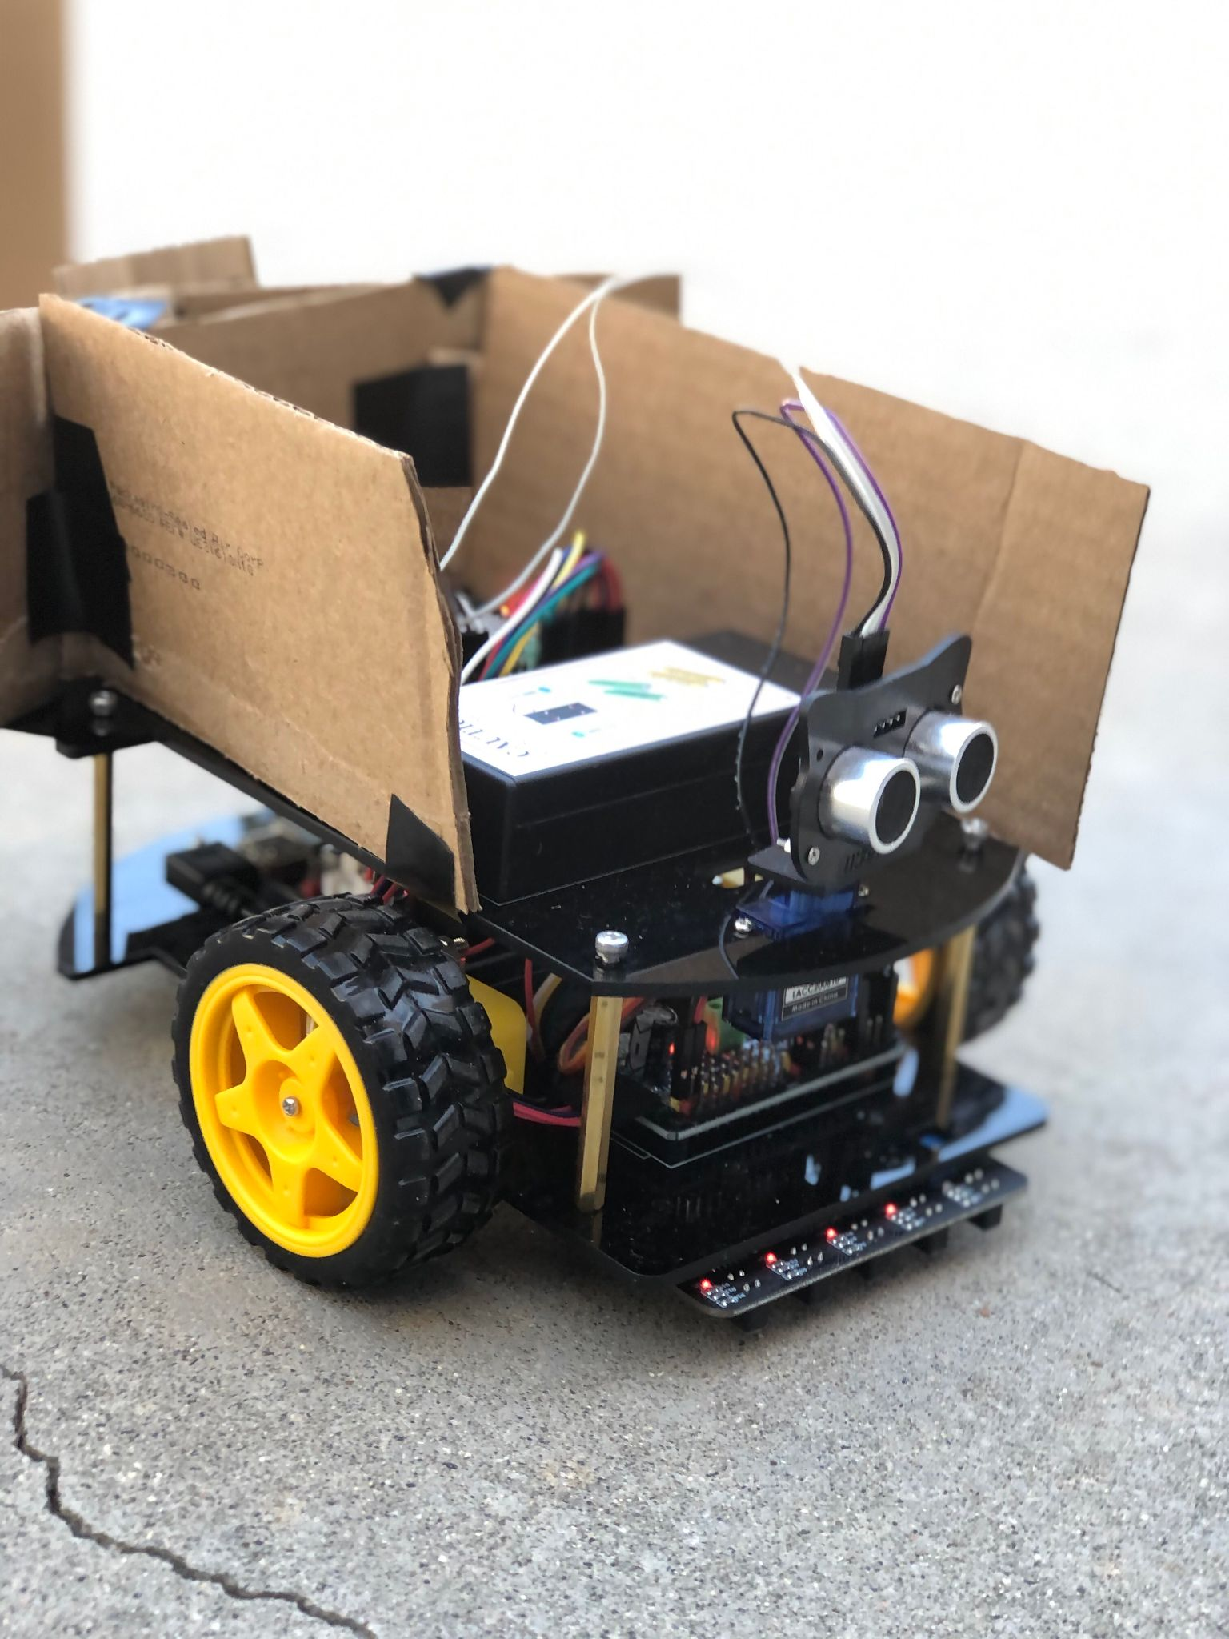
SOLUTIONS
We used cardboard to make the leader easier for the follower sensor to detect
We noticed that the sonar wasn’t detecting edges or objects that are below the sensor. In order to follow the leader, we added cardboard so the sonar was able to reflect back to the leader
We slowed down the leader robot and the follower to make it not have to speed up as much to follow it.
We decreased the range at which the follower searched (looking left and right) when looking for the leader. This helped avoid confusion between distinguishing the leader and the obstacle.
We made the leader give the box more space when it went around it.
Increased the maximum threshold of what the leader was aloud to be near the obstacle.
We created a course correction system to run when the robot was moving parallel to the obstacle.

Slide 5
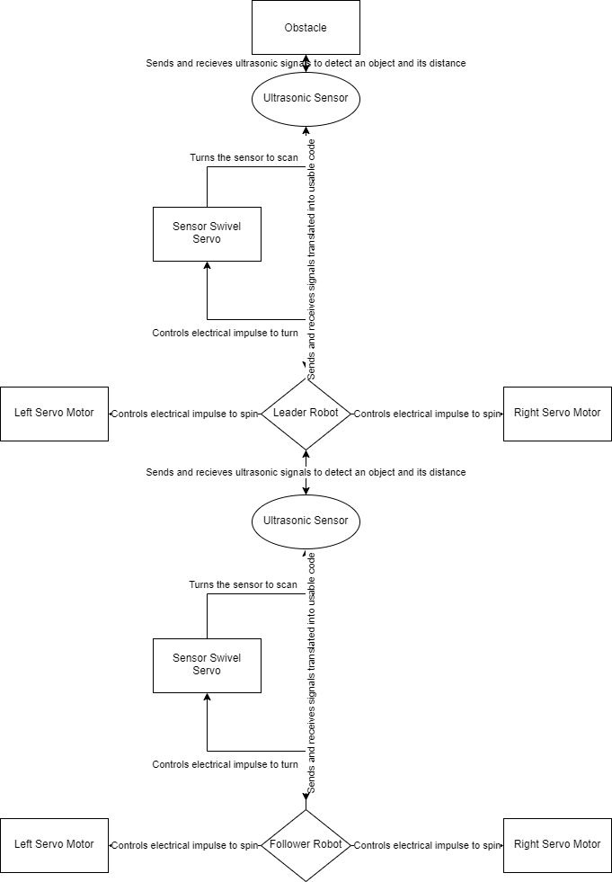
ICD
Name Of Piece | Definition/purpose | Input/Output
Core Robot PI | To send and receive signals in order to control the system. Controls all servos and sensors. | INPUT & OUTPUT Sources - Ultrasonic sensor - IN - Servo Motor -OUT
Wheel Servo Motor | Receives a flow of electricity to spin causing the system to move. | INPUT Sources - Core Robot PI - IN
Sensor Swivel Servo | Receives a flow of electricity in order to turn allowing the sensor to be moved so it can scan. | INPUT Sources - Core Robot PI - IN
Ultrasonic Sensor | Sends out a high frequency signal and detects objects and distance by the signal being returned. | INPUT & OUTPUT Sources - Core Robot PI - IN - Ultrasonic sensor - IN - Core Robot PI - OUT

Slide 6
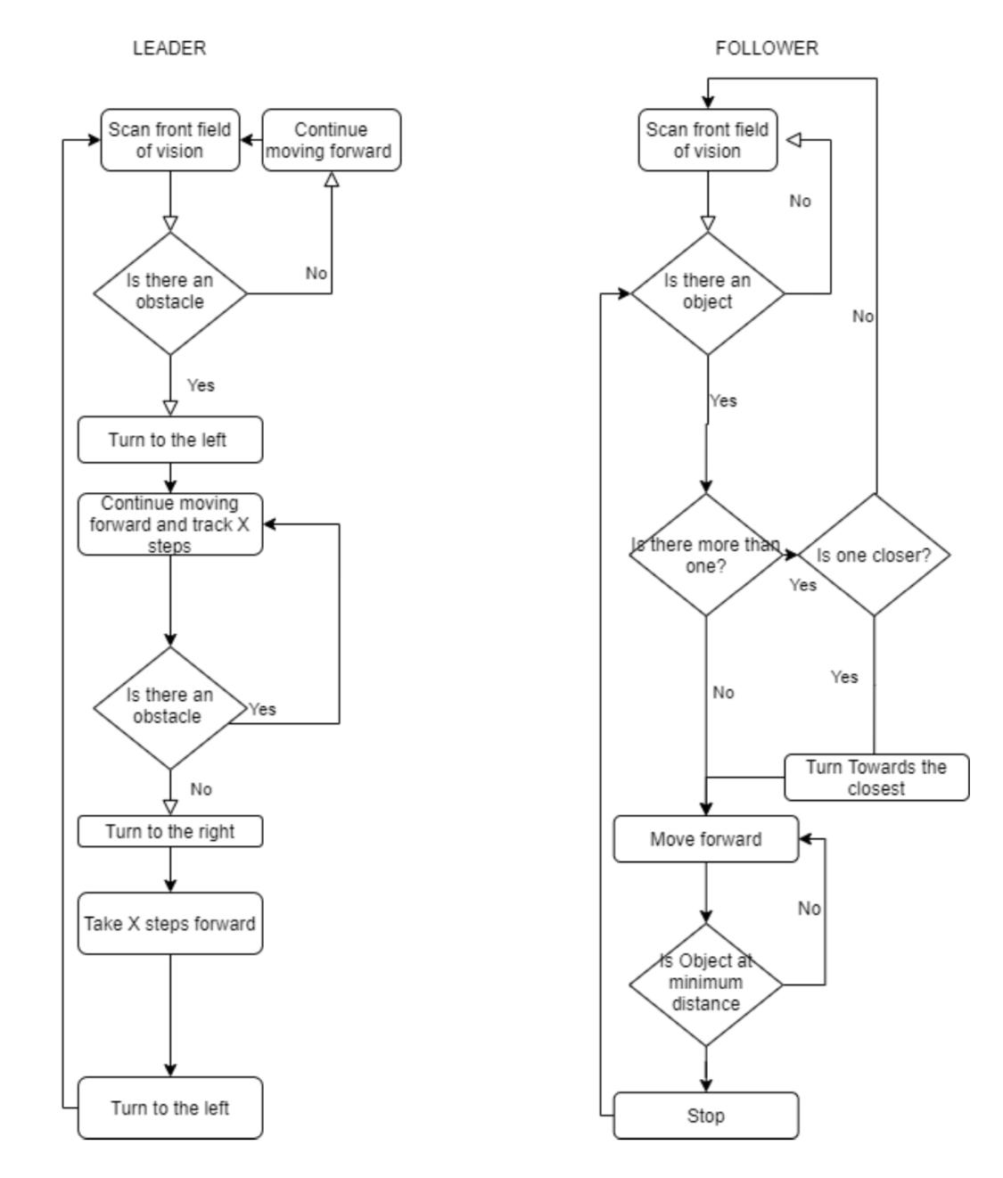
ICD Cont.

Slide 7
Leader - Obstacle Avoidance Stages
Stage 0 (Identify Obstacle):
Center the sensor and check if there is anything in front.
If there isn't anything, move forward a few steps. If there is, then stop and turn left.
Continue loop of checking and moving until an object is detected in front of the robot.
Stage 1 (Deviate from Course):
Focus the sensor on the right. Keep moving forward until there isn't anything to the right.
If there is nothing to the right, stop and turn right.
During this stage, we will track how many times the robot must move forward with 'move' (relevant to step 3).
Stage 2 (Move Past Obstacle):
First, have the robot keep moving forward until it sees something to the right again. This helps account for how early the robot may have initially turned in front of the obstacle.
Once it sees the obstacle, keep moving forward until there is nothing to the right anymore.
If there is nothing to the right, turn right.
Stage 3 (Return to Course):
Move the same number of times back on track that the robot had to initially deviate off the original course.
Once the robot has moved back the same number of steps, then the robot will turn left.
Stage 4 (Return to Neutral State):
Center the sensor and disable obstacle avoidance.

Slide 8
Leader - Additional Functionality
Course Correction:
The robot will compare its current distance from the obstacle with the previous distance during each forward step.
If the robot determines it is moving away from the obstacle, then it will attempt to correct its trajectory by turning slightly towards the obstacle.
Likewise, if it’s getting closer to the obstacle, the robot will adjust by turning slightly away.
Terminating Obstacle Avoidance:
Obstacle avoidance is started as a separate thread to allow for inputs while running.
If the “Obstacle” button is pressed while OA is running, it will stop.
If any other button is pressed while OA is running, the input will be ignored.
Additionally, when obstacle avoidance finishes, it will automatically turn off.

Slide 9
Follower: Following the Leader
Following the Leader
Depending on the different distances between the leader and follower, the follower will take actions to slow, speed up, or stop.
Explanations of Variables
MaxThresh = the maximum distance that is acceptable for the follower to view and search.
midThresh = lower than the max threshold, the follower will speed if this limit is surpassed.
followThresh = the distance that acceptable for the follower to start moving at regular speed.
Equilibrium = the distance between the leader and follower that follower stops at.
minFollowThresh= lower than equilibrium, if the distance is small, then follower will lower it's speed.
minThresh= the distance at which the follower is aloud to be within the leader's radius.
The follower will look straight if there an object detected and is within its maximum threshold.
If leader is at ‘equilibrium’ then the the follower will stop. This means the robot is at the right distance to follow.
If the leader surpasses the equilibrium and the the ‘follow-threshold’ but is lower than the mid threshold the follower will begin to move at regular speed.
The follower will increase its speed if the leader is between mid and maximum threshold. That means the distance is far and follower needs to close that distance.
If the distance is below equilibrium and and above the minimum-follow-threshold, then the robot will slow its speed due to leader being too close to avoid collision.
If the follower distance is less than the minimum threshold, the follower will stop for it is too close to the leader robot.
After the these actions are taken, the follower will keep looking straight to detect and gauge the leader’s distance in order to constantly adjust itself.
These actions will continue as long as the follower senses the leader. (while loop continues).

Slide 10
Follower: Locating the Leader
Locating the Leader and taking action
If the an object/leader is within of reach, the follower will begin looking at 7 different intervals.
It will look left, two intervals between the left and center, center, right, and two intervals between the center and right. These grabs looks for an object/leader to detect and follow, avoiding blindspots in the meantime.
Depending on the sum of these variables the object will calculate a 'deciding' action to take.
sts1 = 1 if there is object on its left
sts2 = 3 if there is an object in the center
sts3 = 5 if there is an object on its right
Else all these values will equal 0, meaning no object was detected on its corresponding side.
If the number is 4 ; two objects were located, left and center. The follower will choose the distance that is least from it to turn and follow.
If the number 8; two objects were located, right and center. The follower will choose the distance that is least from it to turn and follow.
If the number is 9: that means 3 objects were detect from center, right, and left. The follower will choose the distance that is from it to turn and follow.
Depending on the decide variable; the robot will turn right or left, then look straight for it has detected an object/leader to follow.
The robot will continue to look and search until it has tagged an object within its threshold.

Slide 11
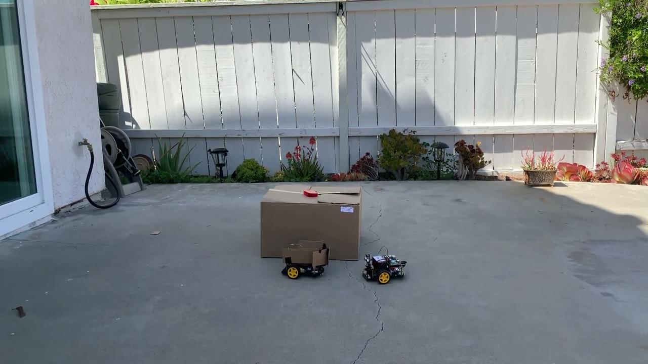
Result

Slide 12
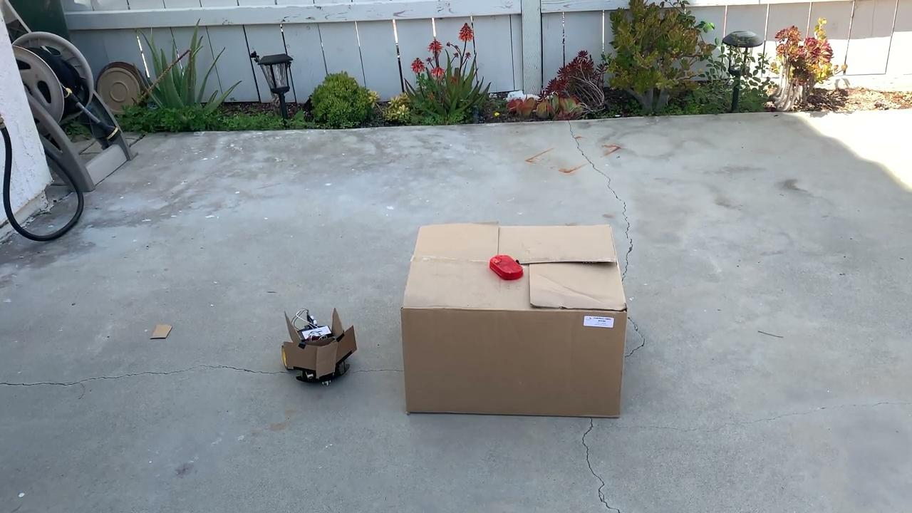

Individual Tasks Demonstrations
OBSTACLE AVOIDANCE
FOLLOWER
OA TERMINATION
ACCEL/DECEL

Slide 13
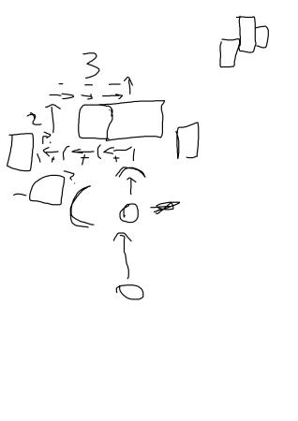
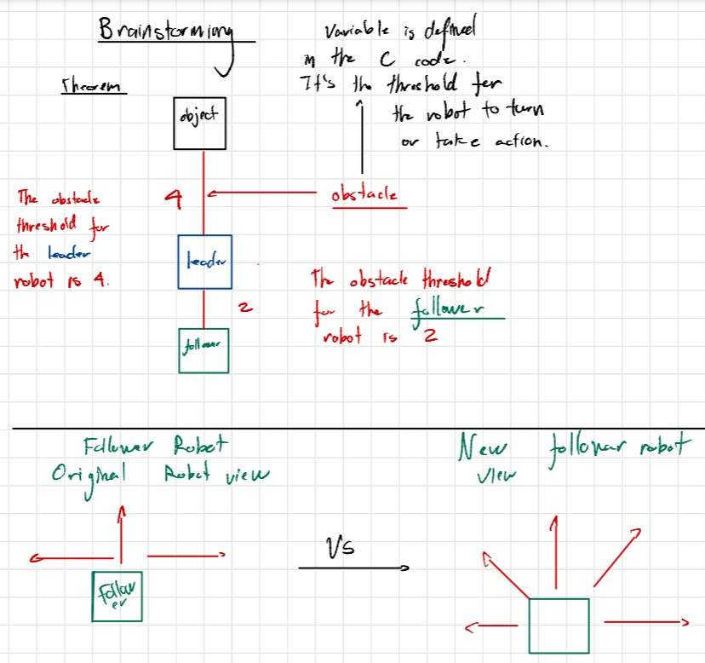
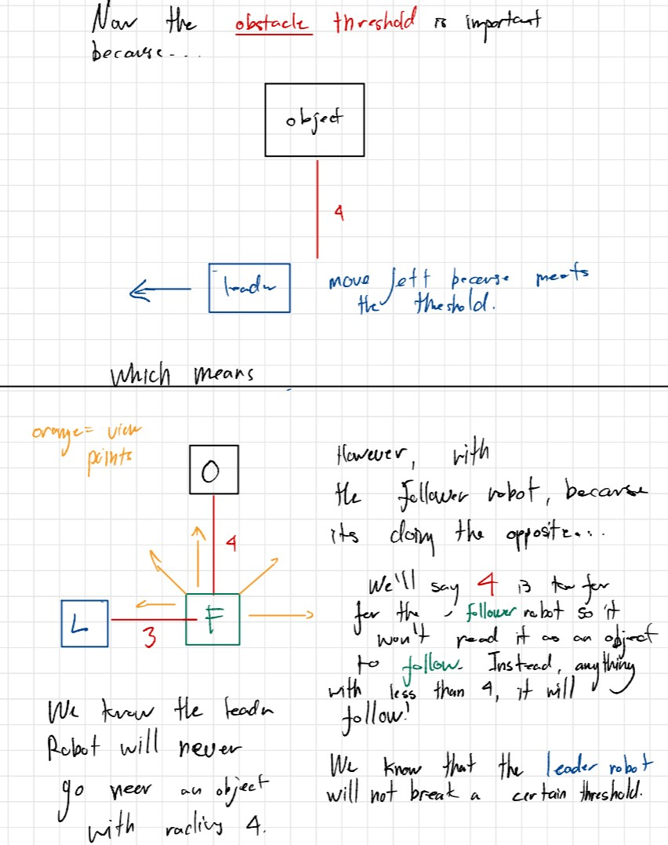
Development Progress Documentation

Slide 14
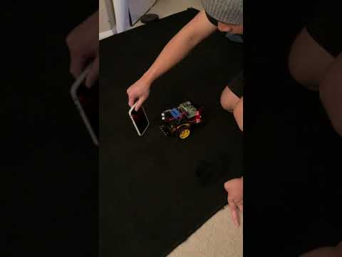
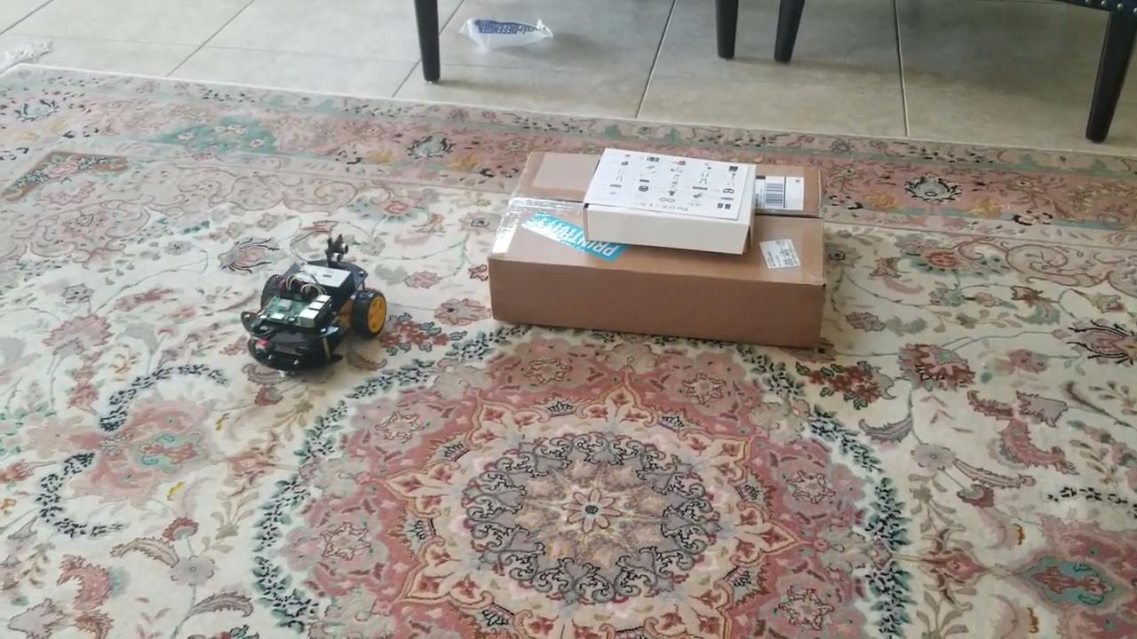
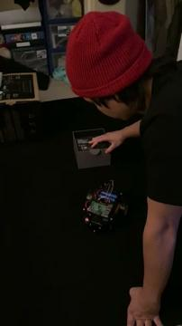
Development Progress Videos

